Slide 1



The Ring of Gyges:
Investigating the Future of Criminal Smart Contracts
IC3 Retreat
17 May 2016
Ari Juels (Jacobs Institute, Cornell Tech, IC3), Ahmed Kosba (UMD), and Elaine Shi (Cornell, IC3)

Slide 2
Challenge #5:
Safety and Compliance
Bitcoin has catalyzed criminal activity.
Smart contracts are more flexible, and could lead to worse.
To defend and reap benefits of (decentralized) smart contracts, we must understand risks…

Slide 3


Criminal Smart Contracts (CSCs)
CSC take advantage of (decentralized) smart contracts to solicit and sell crime.
Smart contracts aim to overcome inefficiencies in business transactions.
CSCs aim to overcome inefficiencies in criminal business transactions.
Smart
Contract

Slide 4


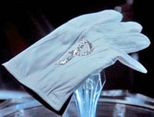
Bitcoin doesn't permit easy
fair exchange
Contractor C
Perpetrator P
$$$
X
Smart contracts do.

Slide 5


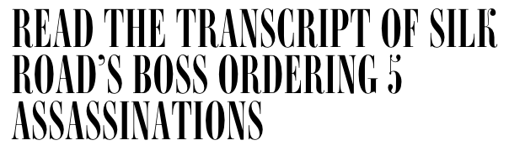
CSCs solve two major business problems in crime
Trust requirements: Dangerous reliance on reputation
E.g., Ross Ulbricht (DPR, Silk Road) solicited six murders for hire
…including one from the FBI
(Vinny D'Agostino, the FBI prosecutor, here today)

Slide 6
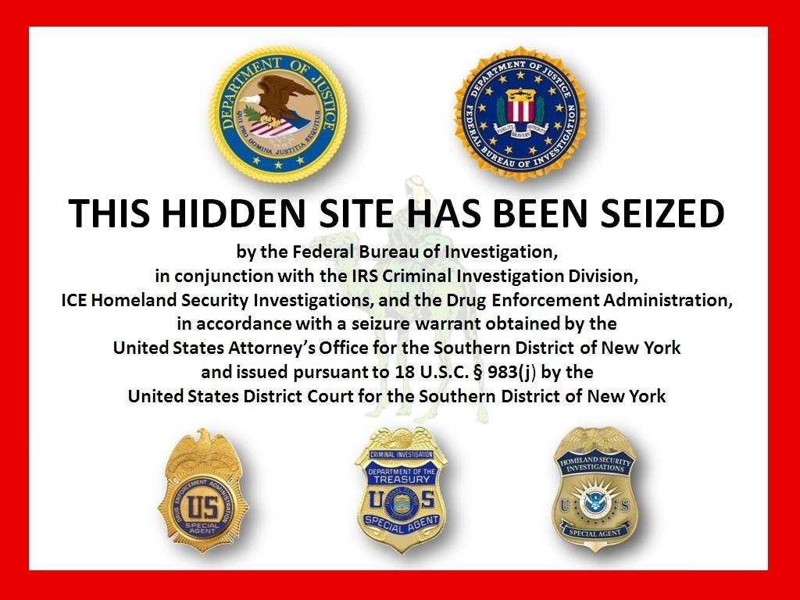
CSCs solve two major business problems in crime
Interference by law enforcement, e.g.,
FBI shuts down your site

Slide 7
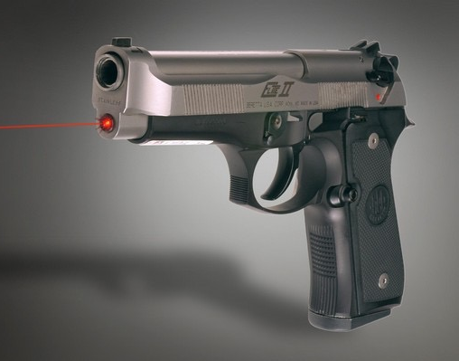
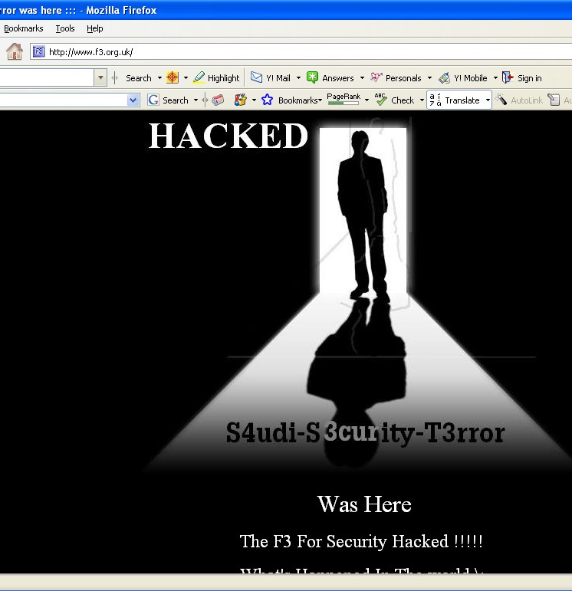
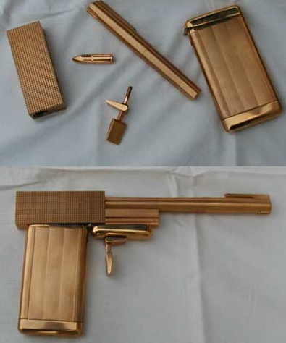
Example Criminal Smart Contract:
"Calling Card" Crimes
(Assassination, Website defacement, Arson, Terrorism, etc.)

Slide 8
Contract: Assassination
Assassination
C offers $reward (e.g., $1,000,000) for the assassination of Senator X
How to verify:
That assassination happened?
That P was responsible?
Solutions:
Authenticated data feed
Notes:
Ross Ulbrecht would have liked to have this

Slide 9







For assassination
Current events
Webpage
contents
Sports
Govt. documents
Weather
Commodity
and equity
prices

Slide 10
Contract: Assassination
Assassination
C offers $reward (e.g., $1,000,000) for the assassination of Senator X
How to verify:
That assassination happened?
That P was responsible?
Solutions:
Authenticated data feed
Calling card

Slide 11
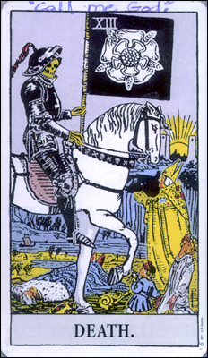
Calling card
Beltway Sniper
Traditionally exotic object left by criminal
E.g., Beltway Sniper's tarot cards
In our setting, a calling card cc is set of details that are:
Hard to guess in advance; and
Reported by media in data feed
Example details:
Day, time, place
Unusual keywords captured in news
E.g., Litvinenko poisoned with "Polonium-210" (2006)
"The Phantom"

Slide 12



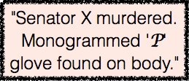


Calling-card CSC
Assassination
P
vcc
P Commits:
cc
X
$reward for Senator X
Authenticated
news feed:
vcc
cc
P Decommits:
$reward
P paid reward:
P

Slide 13
Note that
Same general protocol can be applied to:
Violent crime: murder, arson, assault
Cybercrimes: DoS, website defacement
For many CSCs, e.g., Assassination, C can just walk away!
Once CSC posted, no further interaction

Slide 14
Conclusion
Smart contracts are interesting, powerful, and potentially quite beneficial.
Criminal Smart Contracts are a real threat.
Bitcoin stimulated new criminal ecosystems.
Smart contracts will produce worse.
Assassination is a little far fetched but exemplifies problem
We're studying problem to design defenses preemptively

